Slide 1
Sustaining Drinking Water Sources
Ensuring drinking water sustainability is of paramount importance. Sustaining the sources depends the following major aspects: (i) Source strengthening/sustainability (ii) Regular operation and maintenance and (iii) Replacing the aged infrastructure. Suggestions are invited to
Achieve source strengthening through innovative, measures and/or traditional water harvesting wisdom.
Reduce the operation and maintenance cost of water supply schemes with special focus on decreasing power consumption
Replace/repair the aging infrastructure through unique, cost effective, new/innovative technologies/methods.

Slide 2
GENERAL SPECIFICATIONS OF SURVEY
Width of 4 lane National Highway - 16 m
Length of road surveyed - 5 km
Area of National Highway surveyed –
16X5000 = 80000 square metre
Average rainfall of Udaipur district = 817mm.
Volume of water in litre -
80000X0.817X1000 = 65,360,000litre

Slide 3
Approx 65 million litres of water can be collected by rain water harvesting system on National Highway for length of 5 km.
Per capita demand = 135 lpcd
Population assumed = 2000
Total water required by the village per day
- 135X2000 = 270000litre
No. of days for which water can be utilized
= 65000000/270000 = 240 days

Slide 4
NEED TO HARVEST WATER ?
Ground water recharge has reduced and total water runoff has increased due to increase in built-up areas since last few decades.
This is a new challenge for this decade to save water because there is over exploitation of the water.
It is very difficult to do follow up of ground water stream.
So, we have to develop a policy to harvest the water which is wasted through surface runoff.

Slide 5
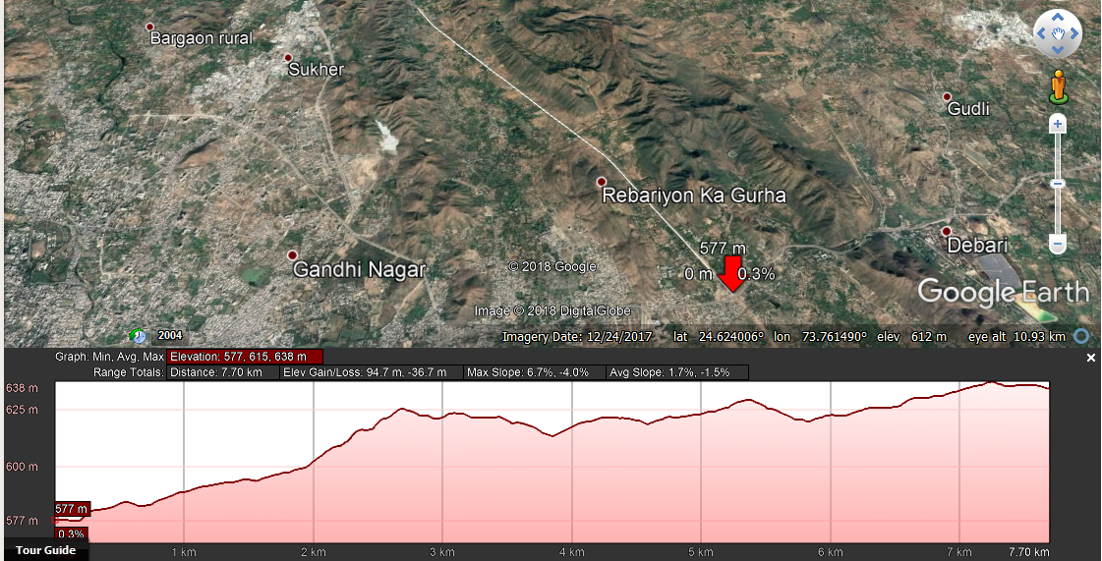
Longitudinal Profile of Pindwara Highway 7.7 km

Slide 6
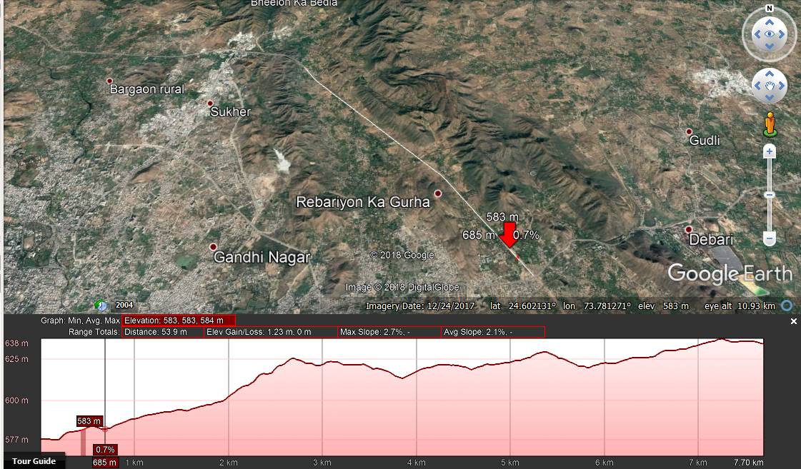
First Reservoir Location

Slide 7
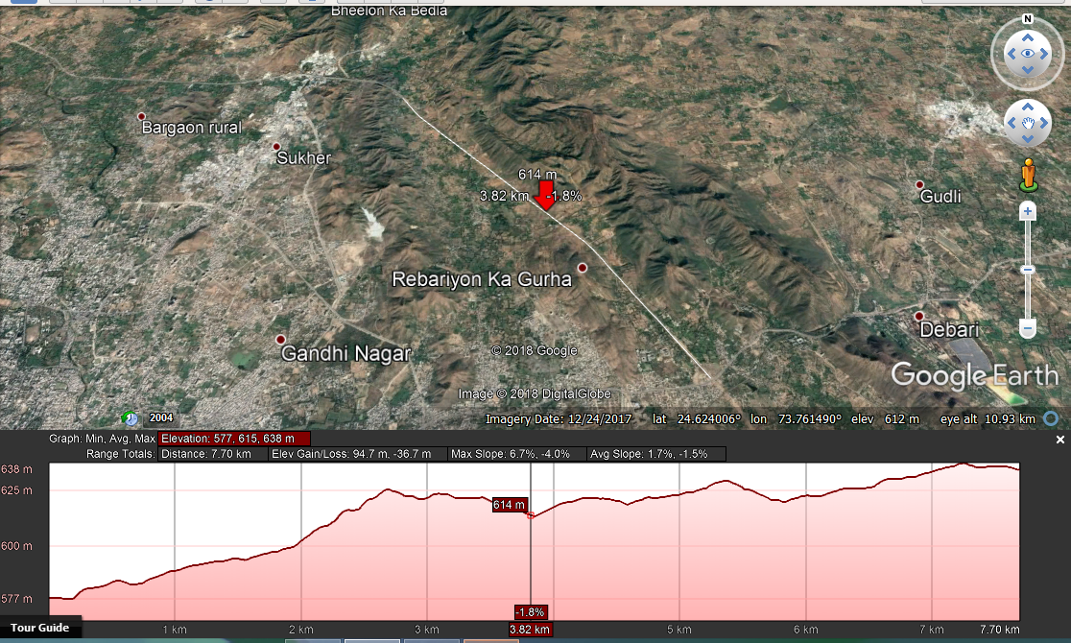
Second Reservoir Location

Slide 8
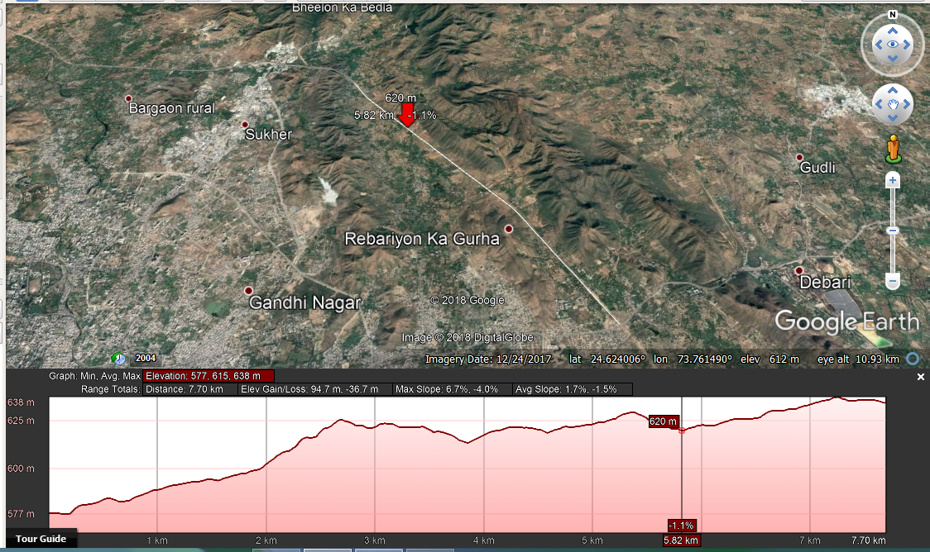
Third Reservoir Location

Slide 9
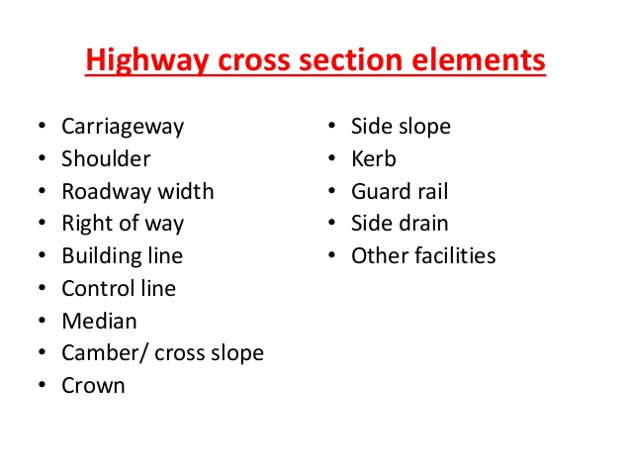

Slide 10
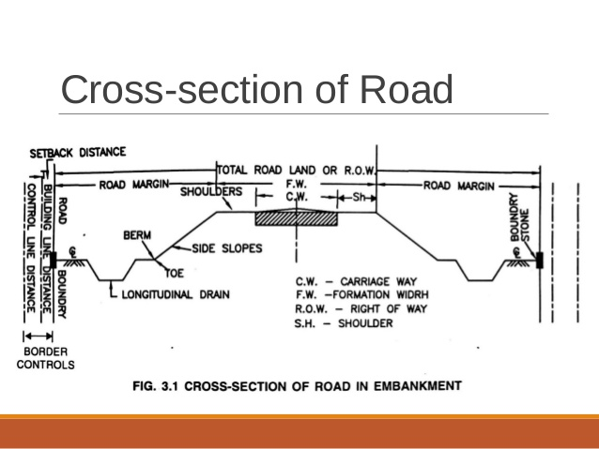

Slide 11
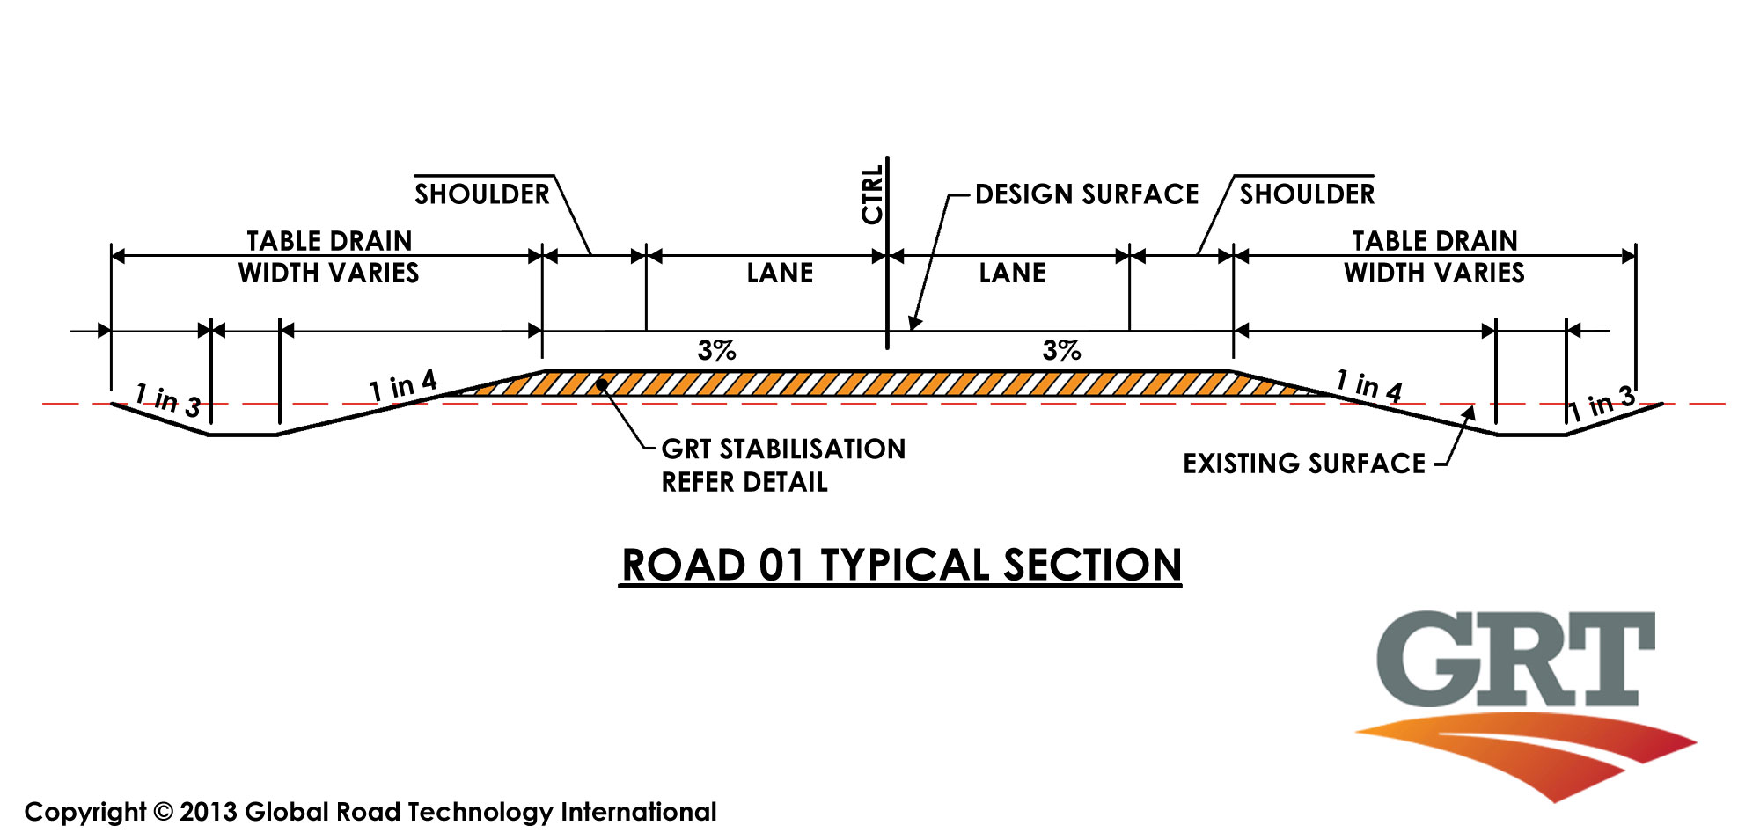

Slide 12
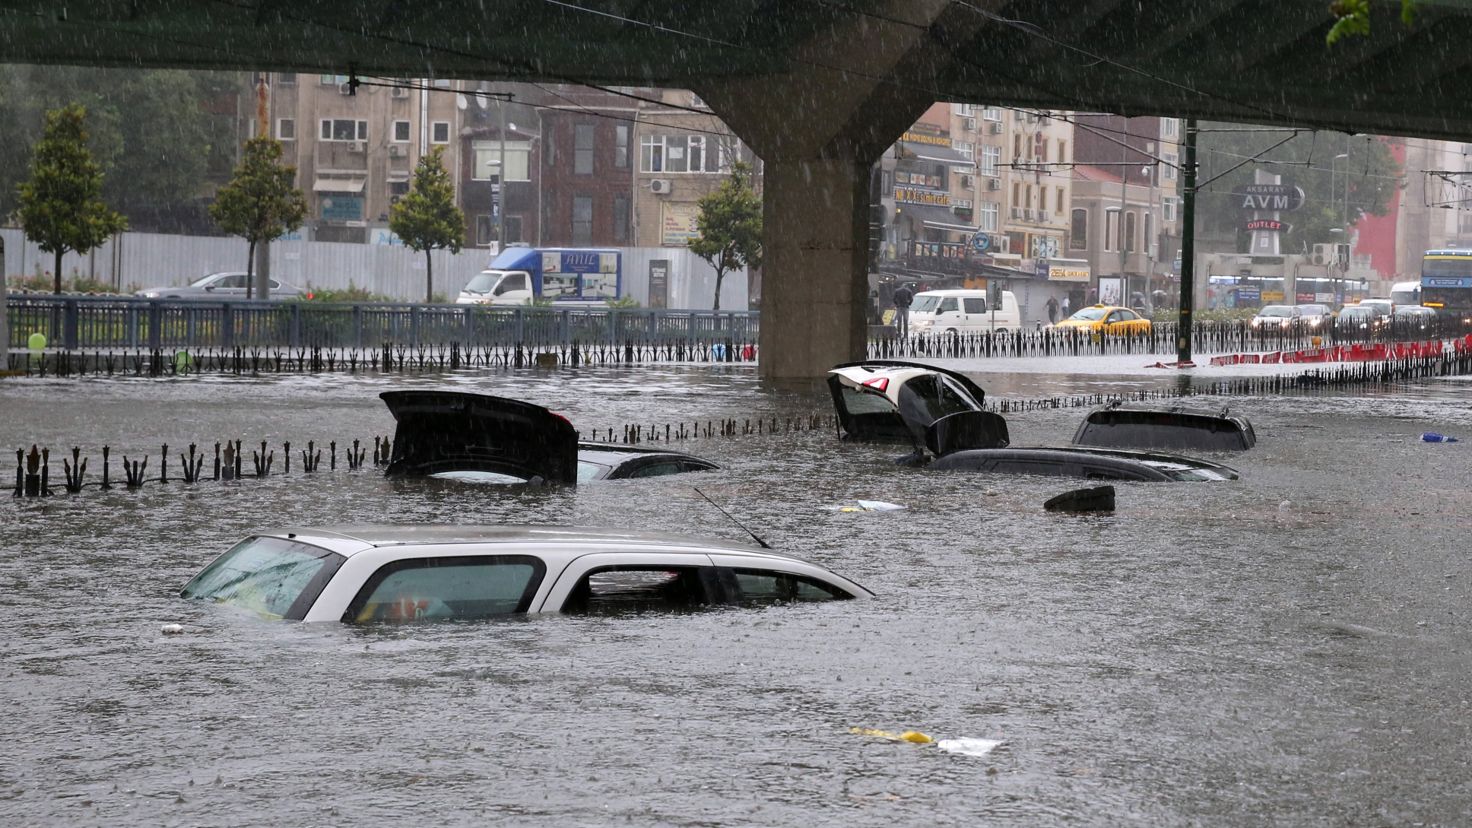

Slide 13
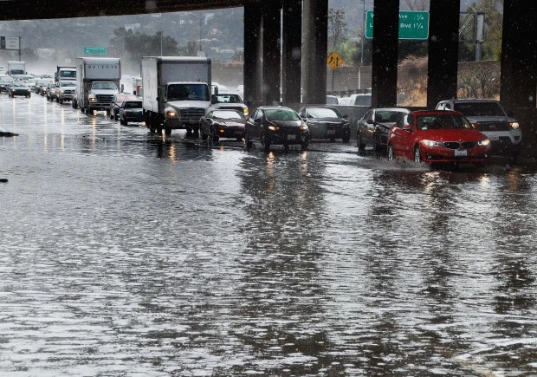

Slide 14
MERITS
Advantage: Prevents Water Accumulation-
Drainage systems can prevent water accumulation that can lead to flooding by directing the water away from your home. Water that over-accumulates in your yard may kill plants. Drainage systems also prevent the accumulation of stagnant water, which can encourage mosquitoes to breed.
Advantage: Reduces Soil Erosion
Over time, stagnant water accumulated can make soil muddy, which in turn can cause soil to erode. Drainage systems maintain balanced moisture in your garden to reduce soil erosion.

Slide 15
Advantage: Removes Toxic Materials and Disease
Organisms
Continuous, heavy rains may cause the water to rise,
which can lead to flash floods, especially when you
live near a big body of water. Often these flash floods
bring contaminated water into your soil. Drainage
systems can remove these toxic materials by draining
them away from your yard.

Slide 16
DIMERITS
Disadvantage: Expensive
Installing a drainage system is a costly investment. You'll end up paying a high price, especially if you hire a professional to install your drainage system. You may also need a permit to install drainage systems, especially if your particular project requires multiple channels and deep excavations. Disadvantage: Maintenance
Regular maintenance of your drainage system will ensure that it functions properly at all times, says the University of Illinois. You have to ensure that the outlet ditches of your subsurface systems are free

Slide 17
Rainwater harvesting is the process of collecting rainwater and putting it to good use. There are different ways in which this task can be accomplished.
Rainwater harvesting, from the common definition of harvesting, is a process that involves collecting rainwater and increasing its value by eliminating impurities or directing it to places where its use is highly required.
Rainwater harvesting, from the common definition of harvesting, is a process that involves collecting rainwater and increasing its value by eliminating impurities or directing it to places where its use is highly required.

Slide 18
from blockages caused by sediment buildup. You'll need to check that debris does not seal the inlet covers. If a tile of your drainage system breaks, you have to replace it. Removing water-loving trees, such as willow, elm, soft maple and cottonwood, from within 100 feet of the drain will keep your drain from blockages caused by overgrown roots, fallen leaves and branches coming from these trees. Ochre, an iron oxide that can block your drain pipe, may also build up; therefore, you constantly have to be on the lookout for it.

